Slide 1
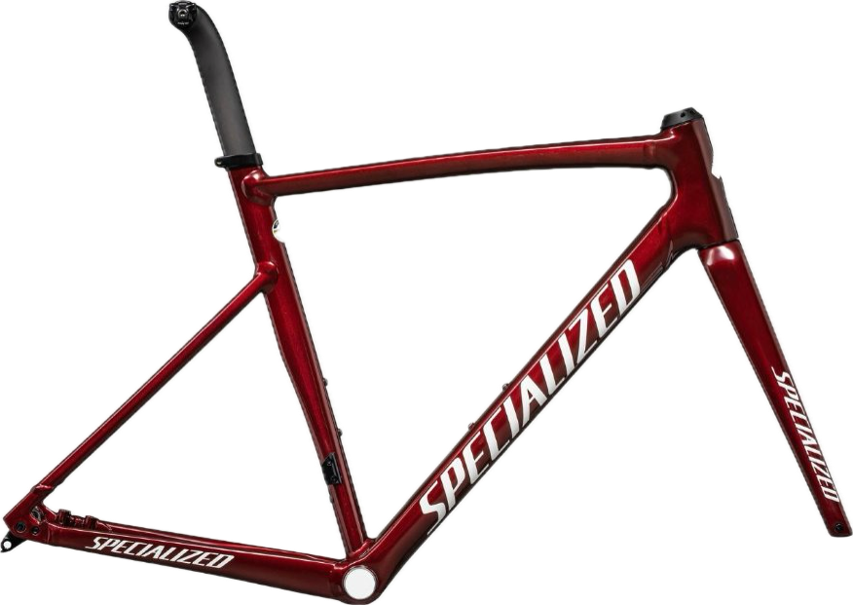
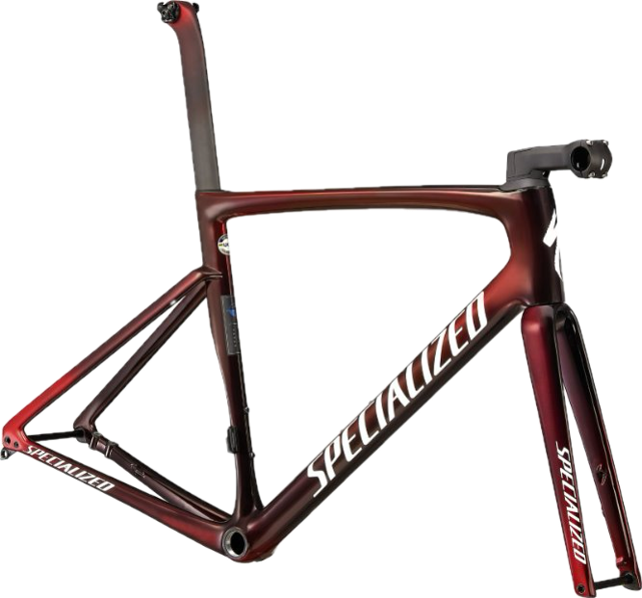
Comparative Life Cycle Assessment of Aluminium and Carbon Fiber Bike Frames
Group – Lazy Caffeine Addicts
Aanand Nataraj Satheesh Manimala,
Alessandro Gorla,
Áron Zsombor Sebó,
Malte Pelle Rietdorf

Slide 2
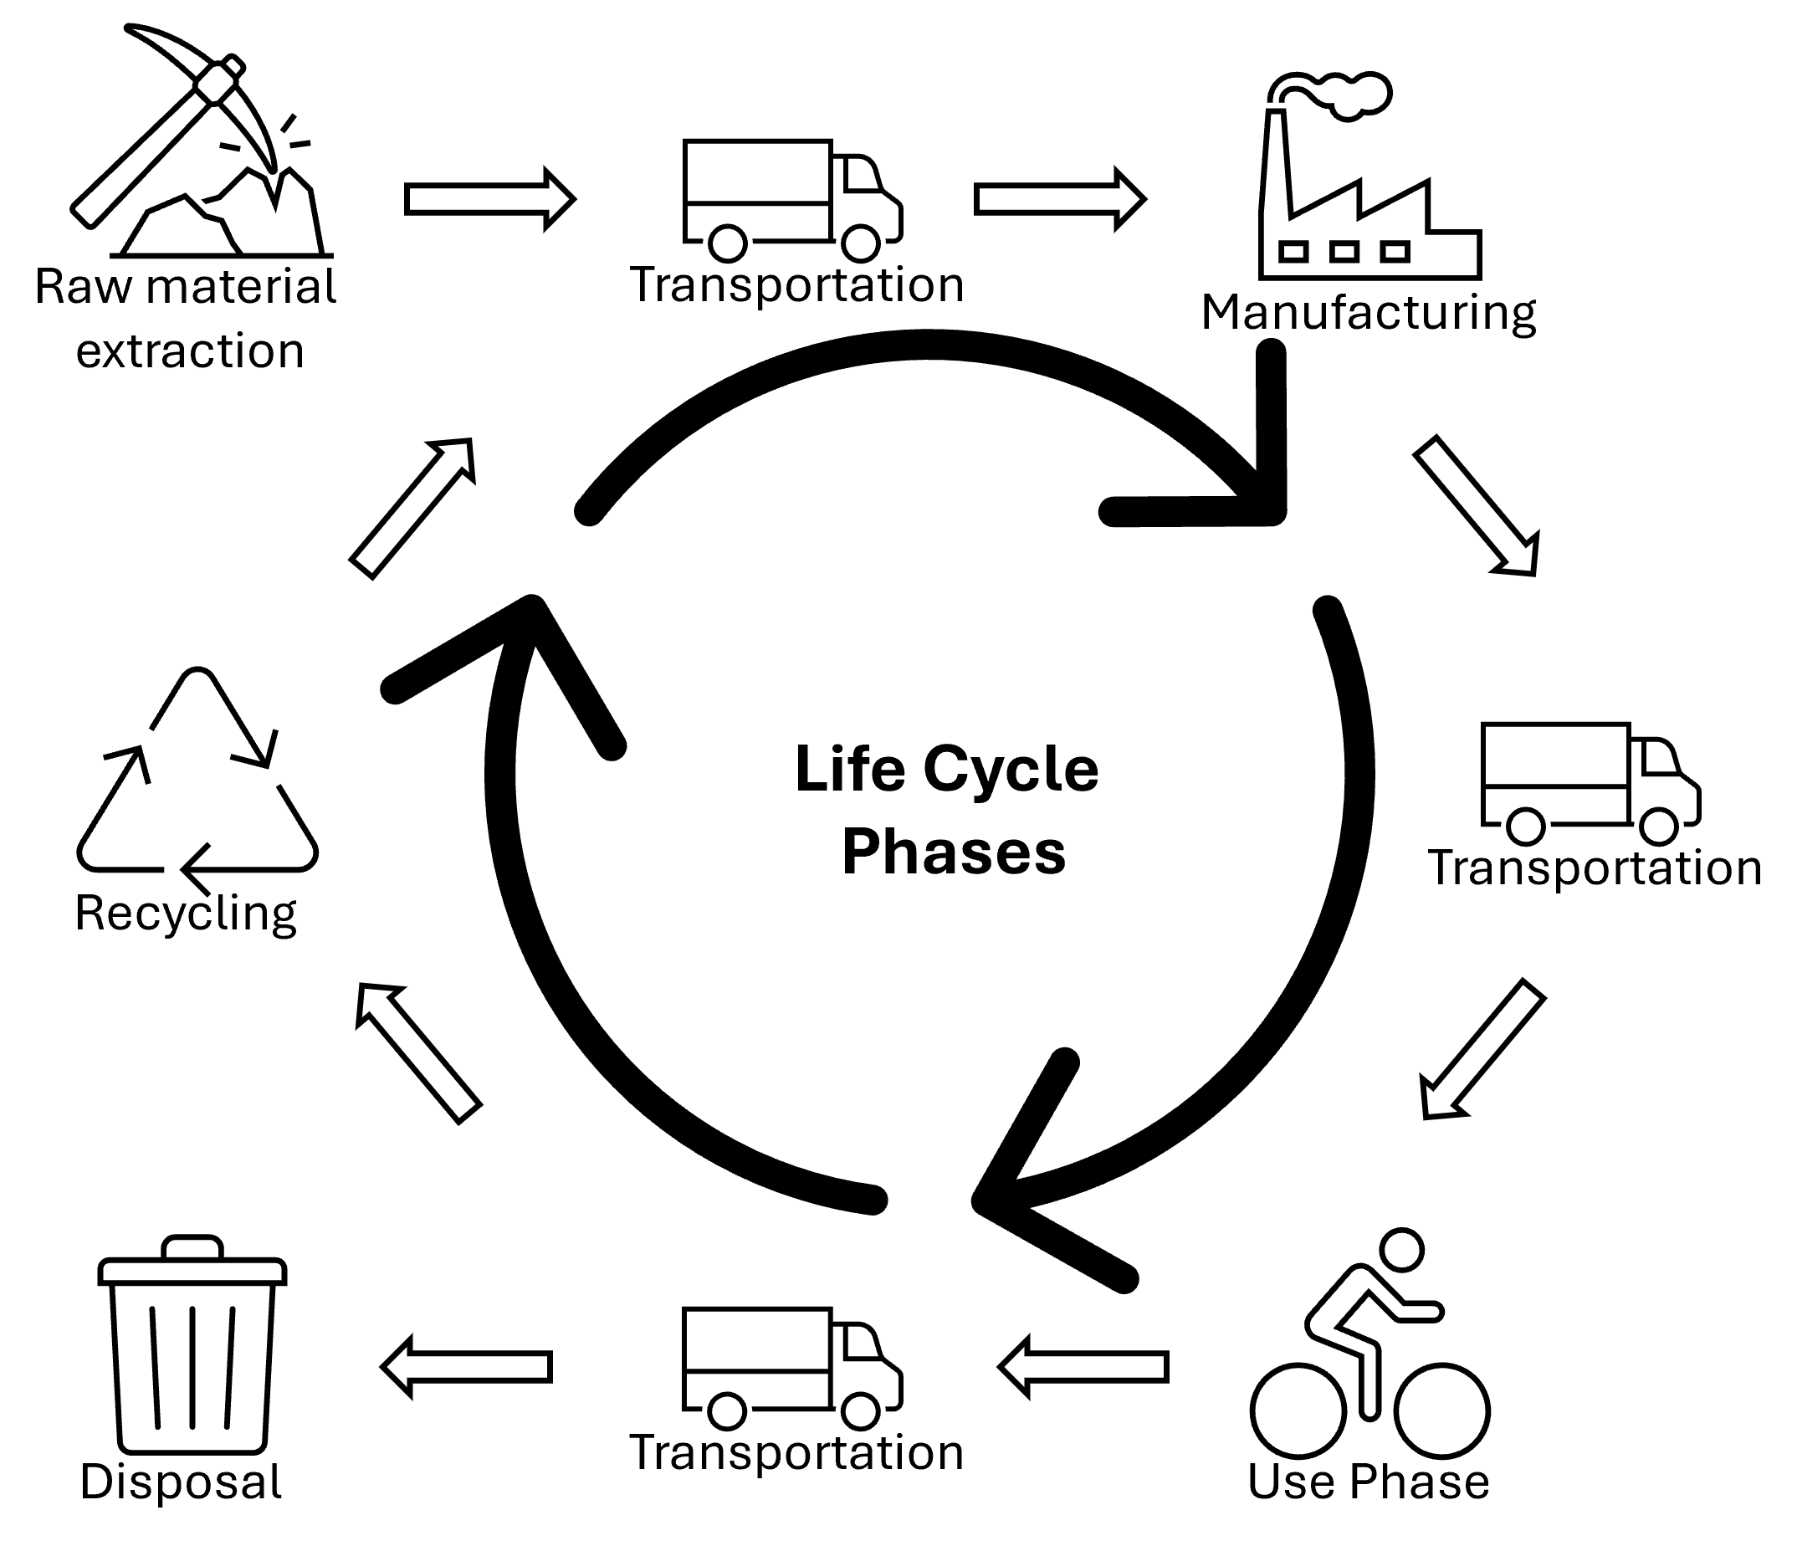
Methodology and Goal and Scope
Functional Unit | 10,000 km
Specialized-Allez Sprint | Specialized-Tarmac SL7
Aluminum | Carbon Fiber
2.35kg | 0.8kg
Notes:
This comparative life cycle assessment follows a cradle-to-grave approach. It begins with raw material extraction, assessing the production of aluminum for the "Specialized-Allez Sprint" and carbon fiber for the "Specialized-Tarmac SL7.“ It follows manufacturing, then use phase estimated for 10 thousand km. Finally the disposal or recycling step. Transportations will be also modelled.
In each phase we will analyze energy use, emissions, waste generation and all possible impacts on the environment.

Slide 3
Aluminium Vs Carbon Fiber
Highly recyclable
Easily repairable
Energy intensive production process
Complex manufacturing process
Varying stiffness and strength
Lightweight
Non-biodegradable
Poor recyclability
Not easily replaceable
_____________________________________________________________________________________________
Notes:
To conduct this assessment, a rough picture of the impacts of the materials on the environment needs to be understood.
Aluminium – it is highly recyclable, nearly 95% of the energy required to produce new aluminium can be saved by recycling old aluminium products.
But the production of aluminium from bauxite ore is highly energy intensive.
On the other hand, the cf provides significant performance advantages because of its lighweight and strength.
But the EOL phase of cf poses a serious risk. It Is nonbiodegradable and has poor recyclability cos of combining thermosetting substances like epoxy with it.

Slide 4
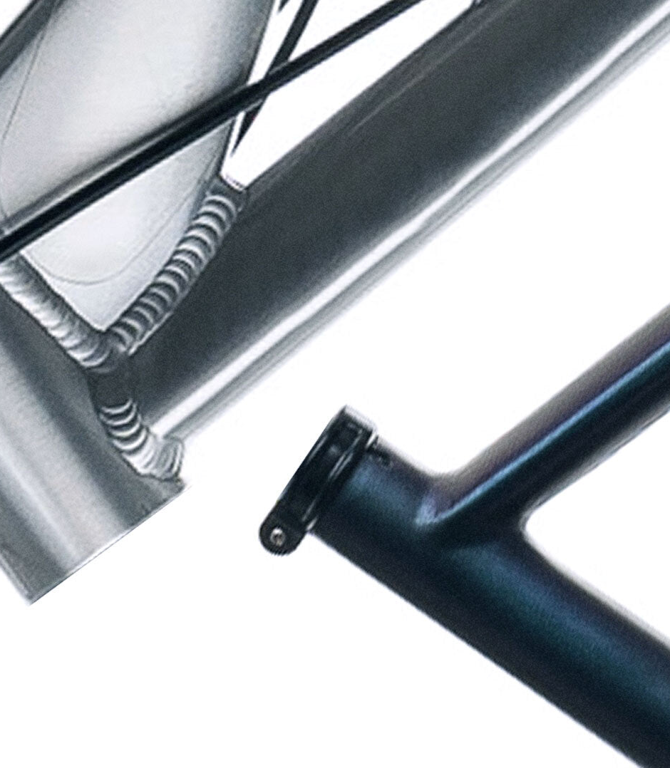



Conclusion and Future Outlook
Environmental impacts
Current challenges
Improvement focus
Notes:
In our upcoming LCA, we will assess key environmental impacts such as Global Warming Potential, water footprint, energy use, and waste generation. We expect to identify challenges, particularly the recyclability of carbon fiber compared to aluminum, and the current limited use of recycled aluminum. Transportation is also likely to contribute significantly to the environmental footprint. Our future efforts will focus on improving recycling technologies for carbon fiber and increasing the use of recycled materials in production for both materials. The findings will help guide sustainability practices in other industries using carbon fiber and aluminum.

